Slide 1
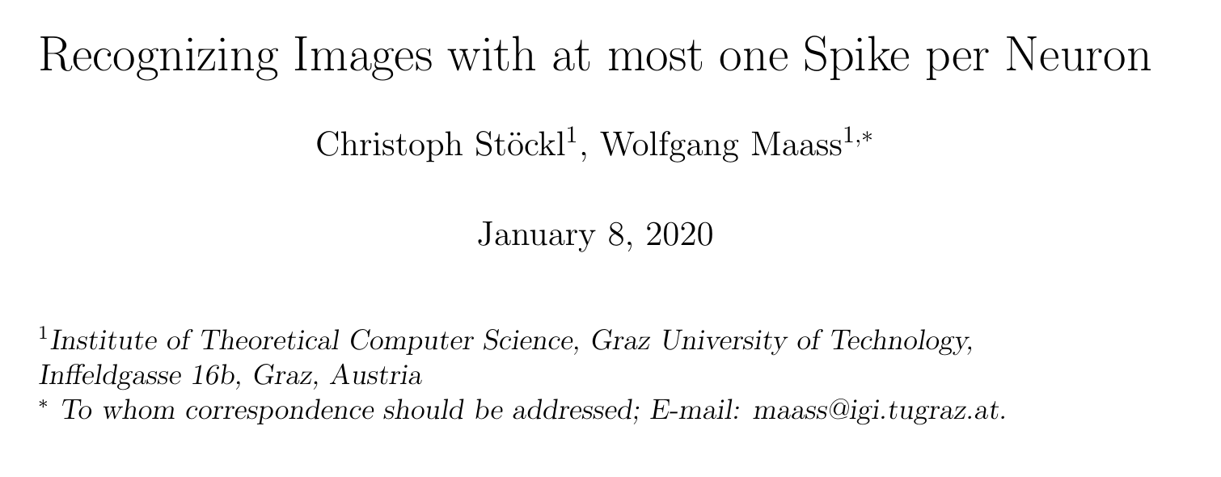
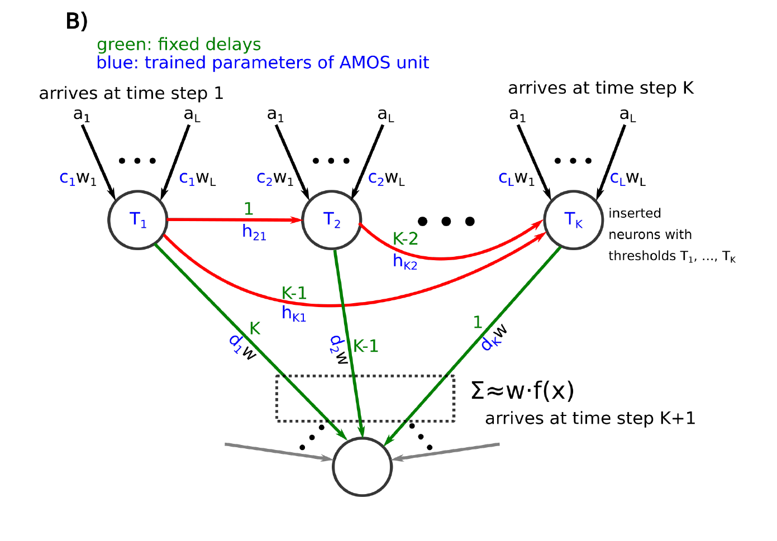
Neural Computing Journal Club
25/03/2020
Presented by
Edward Jones

Slide 9
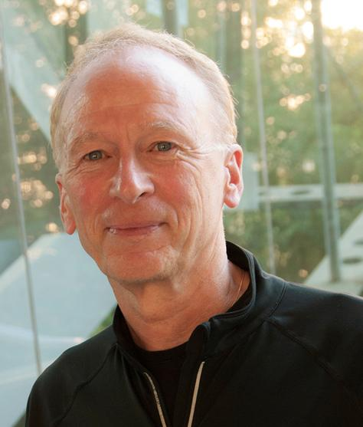
Notes:
We know Maas
Stöckl is probably as Master’s student

Slide 12
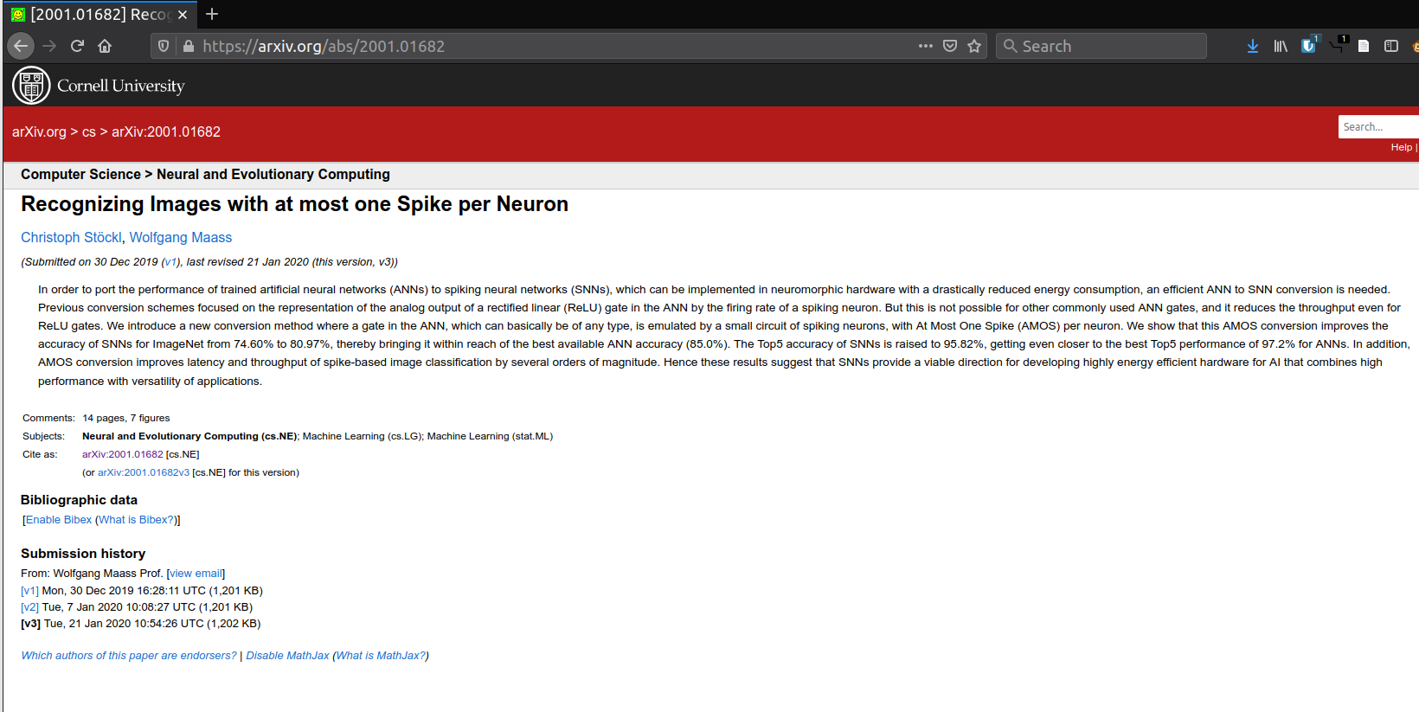

Slide 18
Notes:
Crefeda Faviola + Graham Riley
Bodo

Slide 19
Notes:
Crefeda Faviola + Graham Riley
Bodo

Slide 20
Notes:
Crefeda Rodrigues + Graham Riley
Bodo

Slide 24
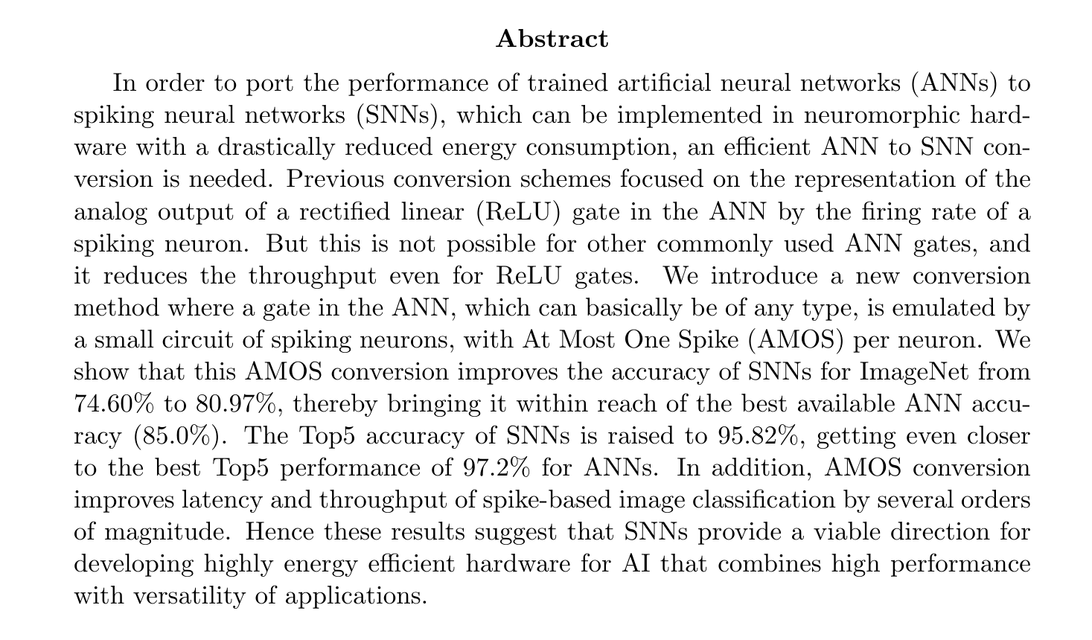

Slide 29
Discussion
This method trades space (neurons) for time
This isn’t good if the number of neurons your hardware simulates is limited
This approach is versatile

Slide 32
Introduction
Rate coding is limited
AMOS similar to temporal coding
AMOS requires order of log N distinct delays for up to N activation
AMOS doesn’t need temporal integration
Can replace any ANN gate (activation function)
Notes:
Should this all go in the introduction?

Slide 35
Notes:
This shouldn’t be the methods really
This is just someone else’s ANN structure and parameters - boring!

Slide 37
Notes:
The middle 8

Slide 38
Notes:
The middle 8

Slide 39
Results
Architecture of the AMOS unit
Approximation of some common ANN gates by ANN units
Application of the AMOS conversion to image classification with SNNs
Results for the classification of images from the CIFAR10 data set
Trade-off between latency and network size of the SNNs

Slide 40
Results
WHAT A AMOS UNIT IS
Architecture of the AMOS unit
Approximation of some common ANN gates by ANN units
Application of the AMOS conversion to image classification with SNNs
Results for the classification of images from the CIFAR10 data set
Trade-off between latency and network size of the SNNs
RESULTS
SPARE DISCUSSION

Slide 41
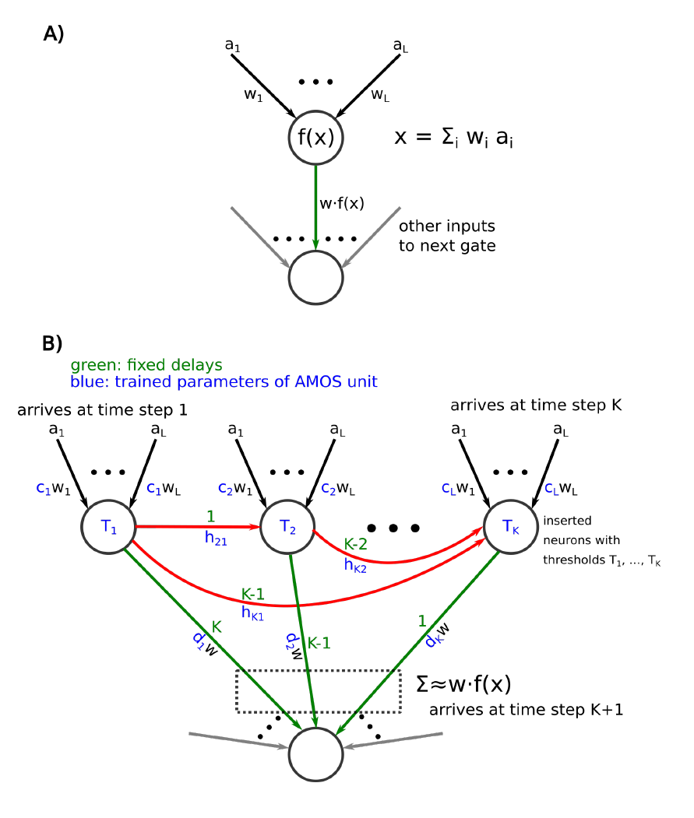
AMOS Unit

Slide 42
AMOS Unit

Slide 43
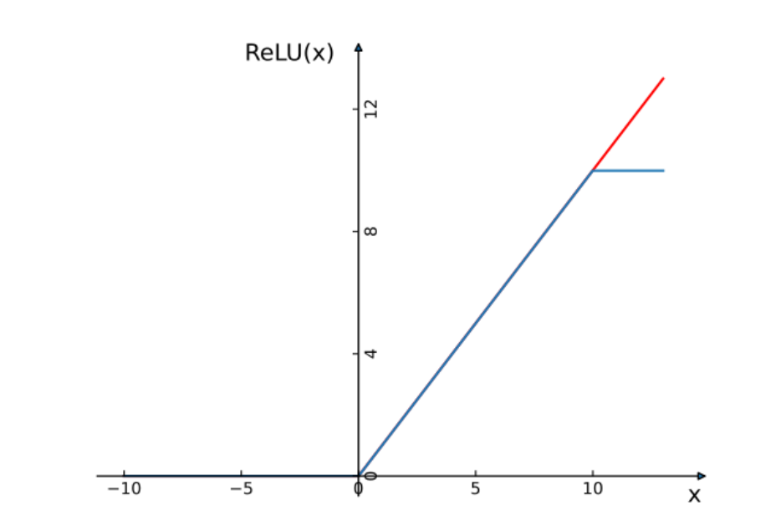
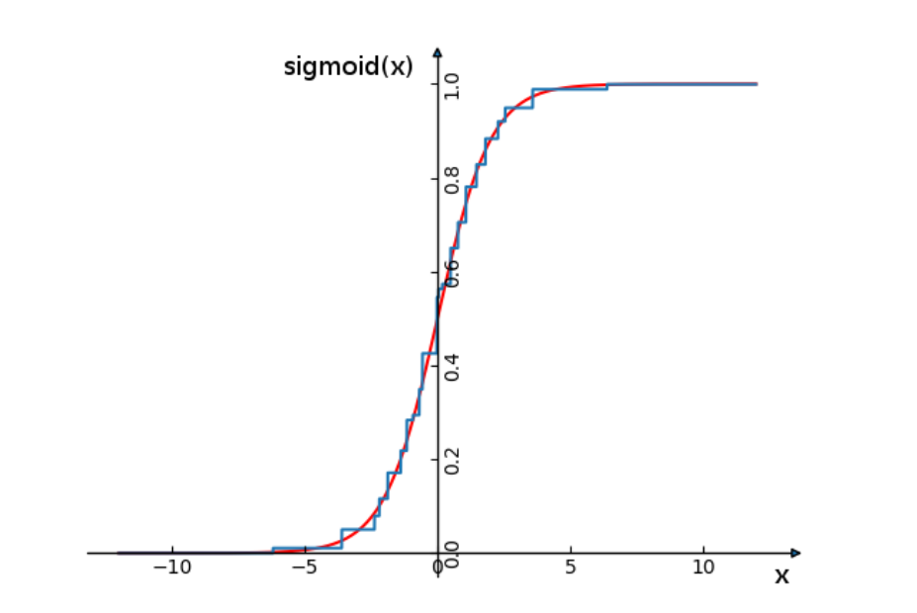

Slide 44
EfficientNet Experimental Results

Slide 45
ResNet Experimental Results

Slide 46
Trade-offs
“Number of layers” vs “size of SNN”
“one can replace the basic architectures of the AMOS units from Fig. 1 and 2 by the more shallow architectures that employ a larger number of spiking neurons.”
Flash ADC vs SA ADC

Slide 47
Conclusion
AMOS works

Slide 48
Conclusion
AMOS works
but

Slide 49
Conclusion
AMOS works
but
it’s not biologically plausible

Slide 50
Conclusion
AMOS works
but
it’s not biologically plausible
but

Slide 51
Conclusion
AMOS works
but
it’s not biologically plausible
but
it does look at conversion differently

Slide 52
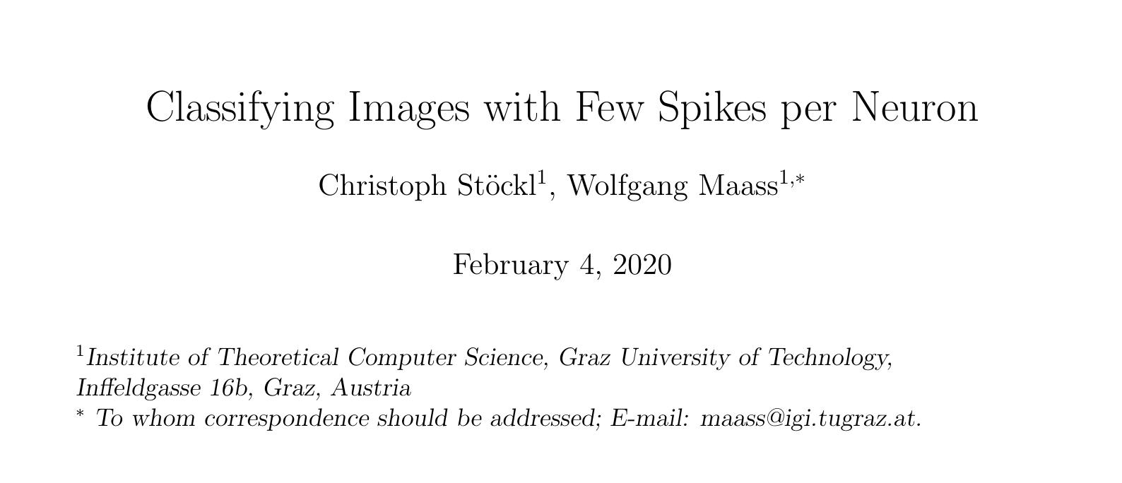
Subsequent Work

Slide 53
AMOS
FS-Unit

Slide 54
Thank you

Slide 55
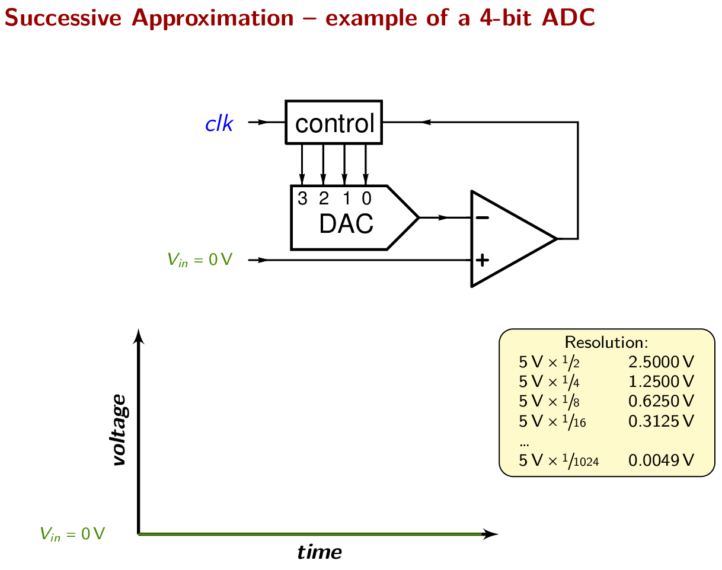
“Animation of a 4-bit Successive Approximation DAC.” by Uwezi is licensed under CC BY-SA 4.0

